Slide 1





“CANDY COMPANY SCHEME MANAGEMENT SYSTEM”

Slide 2



PROBLEM
Managing employee data in a growing organization can be difficult, especially when it comes to adding, removing, or finding employees. Manual methods are often slow and error-prone, and keeping data consistent between sessions is hard.

Slide 3
The Candy Company Scheme Management System solves these problems by providing an easy-to-use program that helps manage employees, shows the company structure, and keeps data saved for future use. This makes administration faster, more accurate, and clearer.

Slide 4
OVERVIEW
This project is a tool for managing employees that mimics the structure of a multi-level marketing company using binary trees. In this system, each employee can recruit up to two subordinates. It also keeps track of their candy collections and gold earnings.

Slide 5







OBJECTIVE
01
02
Tracks reward distribution (candy and gold)
Manages a hierarchical employee structure
03
Automates the calculation of benefits based on recruitment
04
Maintains data persistence across sessions
05
Provides an easy-to-use interface for employee management

Slide 6


SCOPE
The project focuses on managing a simple company hierarchy with these specific scope and boundaries:
Managing up to two direct subordinates for each employee.
Core operations: hire, remove, search, and display employees
Persisting data to a file (candyDatabase.txt) for retrieval.
Simple reward system where upper management benefits from lower-level recruitment

Slide 7
BOUNDARIES
Supports a maximum of two direct subordinates per employee.
Does not include advanced user authentication or graphical interfaces.

Slide 8




FEATURES
Loading and Saving Data
Employee Management
Saves the current organizational structure to the file on exit.
Automatically loads data from candyDatabase.txt on startup.
Add employees under a specified manager.
Remove employees and their subordinates.
Search for employees by name.

Slide 9


FEATURES
Hierarchy Visualization
Gold and Candy Distribution
Display the hierarchical structure of the organization, including gold and candy distribution.
Updates employees' gold and candy values based on hierarchical relationships.

Slide 10

TECHNOLOGIES USED
Programming Language | Frameworks/ Libraries | Tools | Database
C | stdio.h | VS Code | Notepad/TextFile
Programming | stdlib.h | Other Text Editors
Language | string.h | Git
 | unistd.h | GCC COMPILER

Slide 11

Project Structure
CC214L/
├── Main.c # Main Program
├── Main.exe # Executable file of main
├── candyDatabase.txt # TextFile to store data
└── README.md # Project description

Slide 12
USAGE

Slide 13

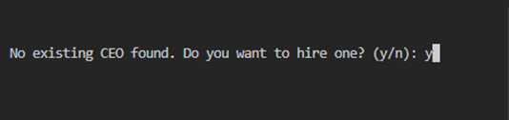
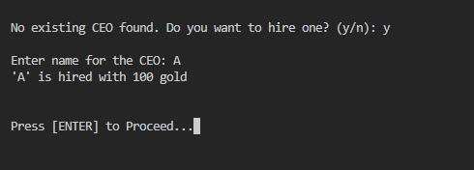

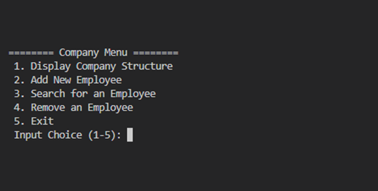
If the database is empty, the user will hire a CEO
After hiring a CEO, the user will press enter and will proceed to the menu.
If the database is not empty, it will automatically display the menu.

Slide 14
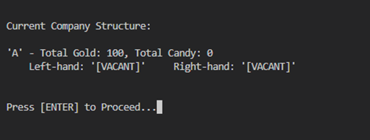
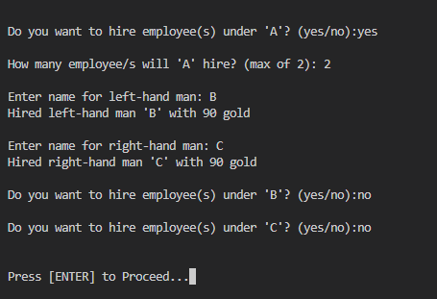
Selecting 1 will display the data inside the database. If an employee or CEO does not
have any employee working under them, it will be labeled as VACANT.
By selecting 2, the program asks the user about hiring employees under them. Of course, the user can say no if satisfied.

Slide 15
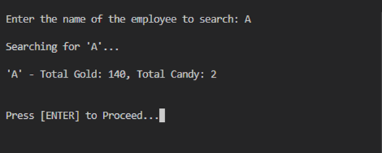
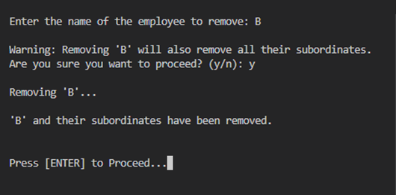
By selecting 3, the program will ask the user a name to search and the program then navigates the name and displays it along with its total gold and candies
By selecting 4, the program will ask the user a name to remove, the program then navigates the name and remove the node along with its subordinates or employees working under them.

Slide 16
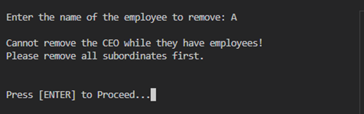
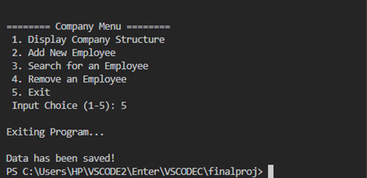
However, if the CEO is about to be removed and still have employees, it will be not removed.
The subordinates must be removed first.
By selecting 5, the program just simply terminates.

Slide 17
Time & Space
Complexity

Slide 18
removeEmployee()
Time Complexity O (n)
Space Complexity O (h)
The function may visit every node in the tree in the worst case.
The space complexity is proportional to the height of the tree due to the recursion stack.

Slide 19
distributeCandy ()
Time Complexity O (h)
Space Complexity O (1)
The function calls distributeCandyUpward, so the time complexity is proportional to the height of the tree.
No additional space is used beyond the recursion stack in distributeCandyUpward.

Slide 20
displayTree()
Time Complexity O (n)
Space Complexity O (h)
The function recursively visits each node in the tree once.
The space complexity is proportional to the height of the tree due to the recursion stack.

Slide 21
searchNode ()
Time Complexity O (n)
Space Complexity O (h)
The function may visit every node in the tree in the worst case.
The space complexity is proportional to the height of the tree due to the recursion stack.

Slide 22
addChildren ()
Time Complexity O (n)
Space Complexity O (h)
The function may visit every node in the tree in the worst case.
The space complexity is proportional to the height of the tree due to the recursion stack.

Slide 23
displayMenu ()
Time Complexity O (1)
Space Complexity O (1)
The function performs a constant time operation.
No additional space is used.

Slide 24
Gold & Candy Flow

Slide 25
CEO
Level 0
A
Gold - 100
Candy - 0

Slide 26

CEO
Level 0
A
Gold - 100
Candy - 0
B
C
Gold - 90
Candy - 0
Level 1

Slide 27

CEO
Level 0
A
Gold - 100
Candy - 0
1 candy => 20 gold
B
C
Gold - 90
Candy - 0
Level 1

Slide 28
CEO
Level 0
A
Gold - 100
Candy - 0
+ 40
+ 2
1 candy => 20 gold
B
C
Gold - 90
Candy - 0
Level 1

Slide 29
CEO
Level 0
A
Gold - 140
Candy - 2
1 candy => 20 gold
B
C
Gold - 90
Candy - 0
Level 1

Slide 30
CEO
Level 0
A
Gold - 140
Candy - 2
1 candy => 20 gold
B
C
Gold - 90
Candy - 0
Level 1
D
E
F
G
Gold - 80
Candy - 0
Level 2

Slide 31
CEO
Level 0
A
Gold - 140
Candy - 2
1 candy => 20 gold
B
C
Gold - 90
Candy - 0
+ 40
Level 1
+ 2
D
E
F
G
Gold - 80
Candy - 0
Level 2

Slide 32
CEO
Level 0
A
Gold - 140
Candy - 2
1 candy => 20 gold
B
C
Gold - 130
Candy - 2
Level 1
D
E
F
G
Gold - 80
Candy - 0
Level 2

Slide 33

CEO
Level 0
A
Gold - 140
Candy - 2
+ 40
+ 40
+ 2
+ 2
(B)
(C)
1 candy => 20 gold
+ 2
+ 2
B
C
Gold - 130
Candy - 2
Level 1
D
E
F
G
Gold - 80
Candy - 0
Level 2

Slide 34
CEO
Level 0
A
Gold - 220
Candy - 6
1 candy => 20 gold
B
C
Gold - 130
Candy - 2
Level 1
D
E
F
G
Gold - 80
Candy - 0
Level 2

Slide 35
CEO
Level 0
A
Gold - 220
Candy - 6
1 candy => 20 gold
B
C
Gold - 130
Candy - 2
Level 1
+ 2
D
E
F
G
Gold - 80
Candy - 0
Level 2
Level 3
H
I
J
K
L
M
N
O
Gold - 70
Candy - 0

Slide 36
CEO
Level 0
A
Gold - 220
Candy - 6
1 candy => 20 gold
B
C
Gold - 130
Candy - 2
Level 1
+ 2
D
E
F
G
Gold - 80
Candy - 0
+ 40
Level 2
+ 2
Level 3
H
I
J
K
L
M
N
O
Gold - 70
Candy - 0

Slide 37
CEO
Level 0
A
Gold - 220
Candy - 6
1 candy => 20 gold
B
C
Gold - 130
Candy - 2
Level 1
+ 2
D
E
F
G
Gold - 120
Candy - 2
Level 2
Level 3
H
I
J
K
L
M
N
O
Gold - 70
Candy - 0

Slide 38
CEO
Level 0
A
Gold - 220
Candy - 6
1 candy => 20 gold
B
C
Gold - 130
Candy - 2
+ 40
+ 40
Level 1
+ 2
+ 2
+ 2
+ 2
+ 2
+ 2
(F)
(G)
D
E
F
G
Gold - 120
Candy - 2
Level 2
Level 3
H
I
J
K
L
M
N
O
Gold - 70
Candy - 0

Slide 39
CEO
Level 0
A
Gold - 220
Candy - 6
1 candy => 20 gold
B
C
Gold - 210
Candy - 6
Level 1
D
E
F
G
Gold - 120
Candy - 2
Level 2
Level 3
H
I
J
K
L
M
N
O
Gold - 70
Candy - 0

Slide 40
CEO
Level 0
A
Gold - 220
Candy - 6
+ 80
+ 80
+ 4
+ 4
(B)
(C)
1 candy => 20 gold
+ 4
+ 4
B
C
Gold - 210
Candy - 6
Level 1
D
E
F
G
Gold - 120
Candy - 2
Level 2
Level 3
H
I
J
K
L
M
N
O
Gold - 70
Candy - 0

Slide 41
CEO
Level 0
A
Gold - 380
Candy - 14
1 candy => 20 gold
B
C
Gold - 210
Candy - 6
Level 1
D
E
F
G
Gold - 120
Candy - 2
Level 2
Level 3
H
I
J
K
L
M
N
O
Gold - 70
Candy - 0

Slide 42


ACKNOWLEDGEMENTS
—Project Team:
Marco Montellano
Fanny Rose Caballes
Benjie Sumile
Angel Mae Santosidad
Hazzel Canama
Vincent Bernabe Romeo
Justin Dumon

Slide 43
ACKNOWLEDGEMENTS
—Resources:
Educational online materials on binary tree structures.
GeeksforGeeks: Provided detailed tutorials on binary trees,
data structures, and memory management in C.
Programiz: Provided additional reference materials on
advanced C topics like recursion and pointers.
W3Schools: Helped clarify concepts related to tree
traversal and file handling in C.
GitHub: Served as a version control platform and collaborative
space for team members to share and
review code.

Slide 44
ACKNOWLEDGEMENTS
—Special Thanks
Special appreciation to our professor and fellow leaders of the group who guided us throughout the development of this Data Structures and Algorithms final project.

Slide 45




Contact Information
E-mail:
crmchs.montellano.marco@gmail.com
GitHub:
https://github.com/macoy147/candy-company-scheme-management-system.git

Slide 46

THANK YOU
Happy New Year Sir!

